Slide 1

dfm_tools
A Python package for D-FlowFM modelbuilding and post-processing
Jelmer Veenstra

Slide 2

About myself
Studied Water Engineering and Management at University of Twente
Advisor/researcher hydrodynamics at Deltares since 2017
Development of hydrodynamic models (coastal/estuarian/global regions)
Python tools for creating and automating generic workflows

Slide 3



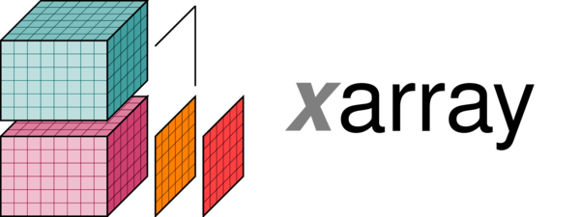




dfm_tools: the concept
What:
a Python package for D-FlowFM modelbuilding and post-processing
contains convenience functions built on top of other packages like xarray, xugrid, HYDROLIB-core, MeshkernelPy and many more
sharing of workflows among users (colleagues/external)
no need to re-invent the wheel
Where:
code on github: https://github.com/Deltares/dfm_tools
installable via pip
jupyter notebooks with example code
xugrid

Slide 4
Pre-processing: Modelbuilder

Slide 5
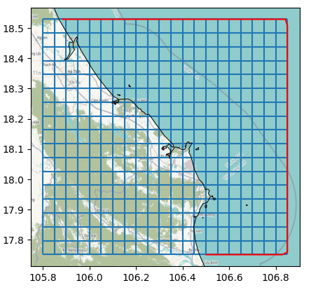
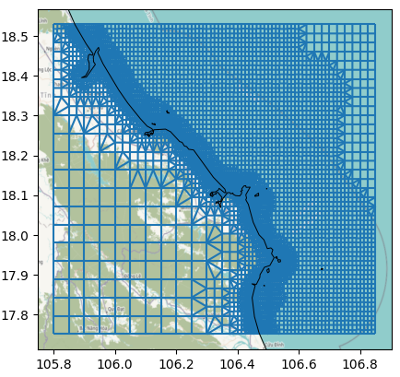
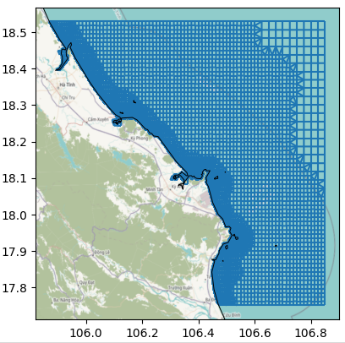
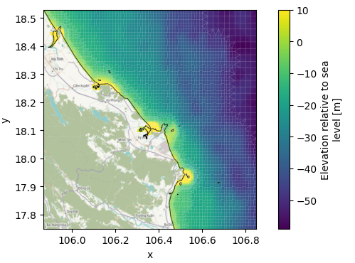
Grid generation with MeshKernelPy
MeshKernelPy: A Python package wrapping MeshKernel (meshing algorithms in C++)
Generation of grids: regular, refinement, deletion, interpolation
Multiple mesh instances: Mesh1D, Mesh2D, Contacts

Slide 6
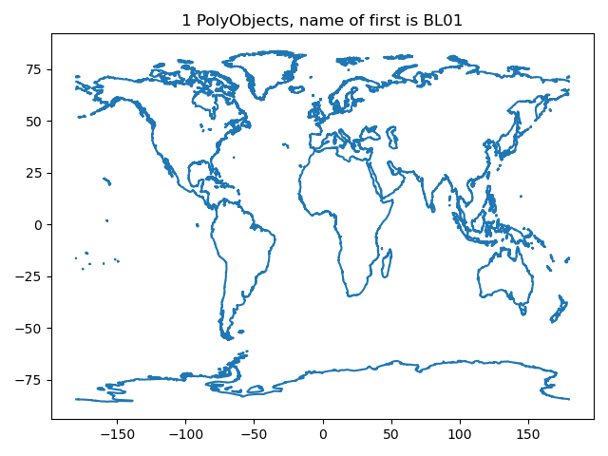
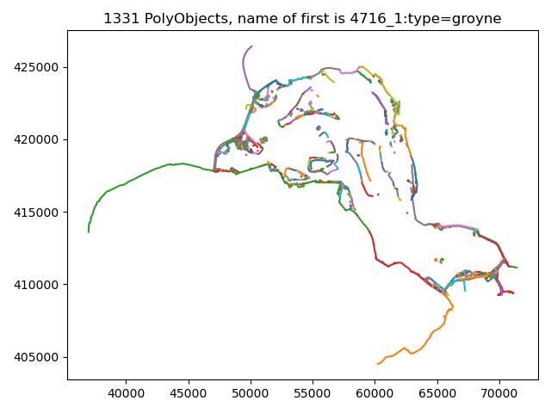
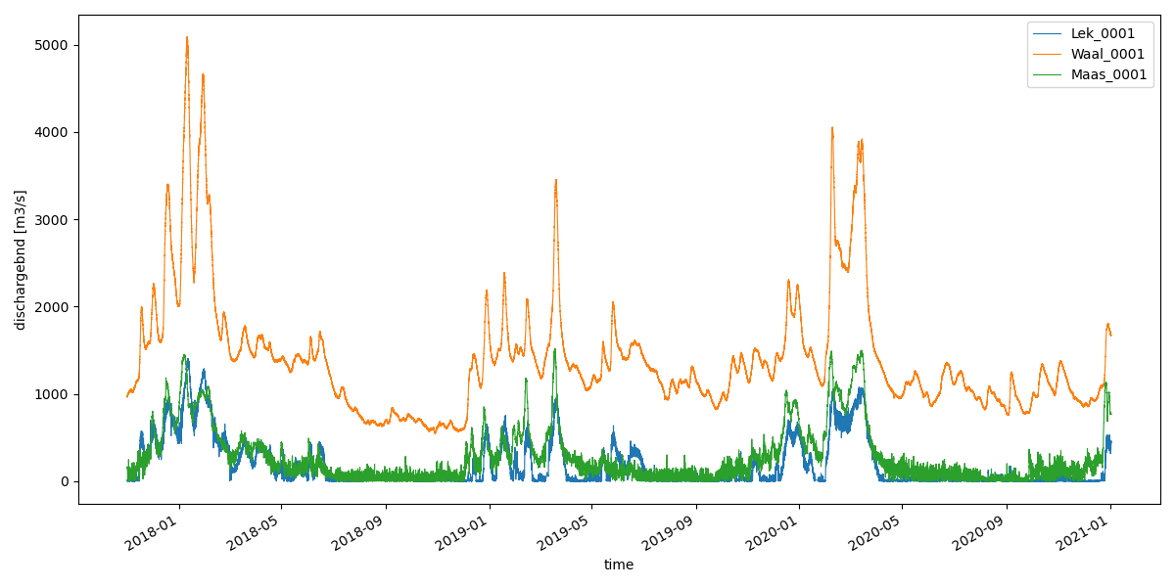
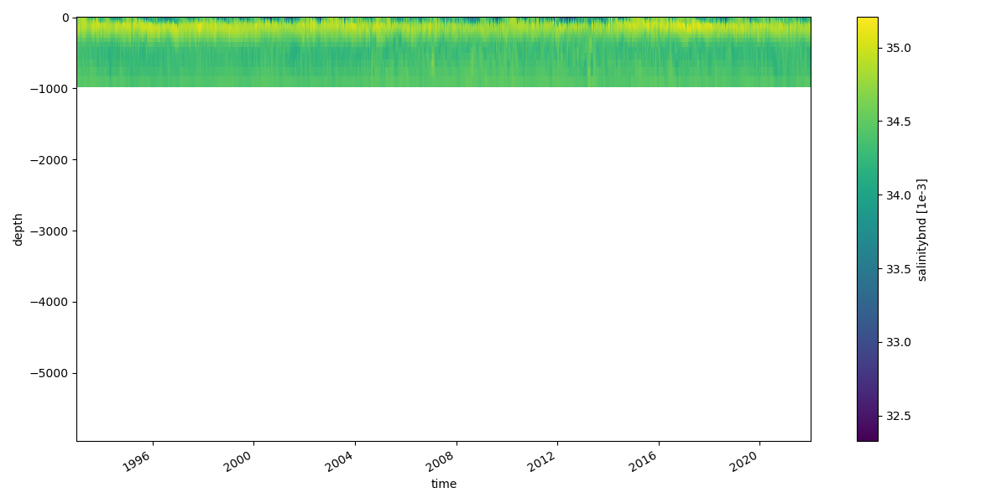
Reading + plotting of D-FlowFM input files
HYDROLIB-core for i/o of D-FlowFM model input files
conversion to xarray/pandas datasets with dfm_tools
figures: pol/pli/pliz/ldb and bc files

Slide 7
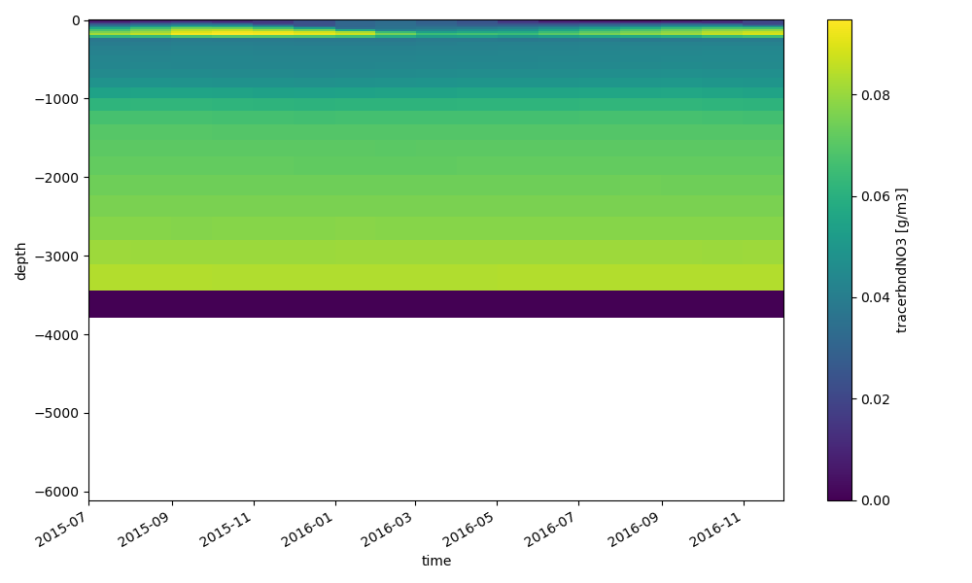
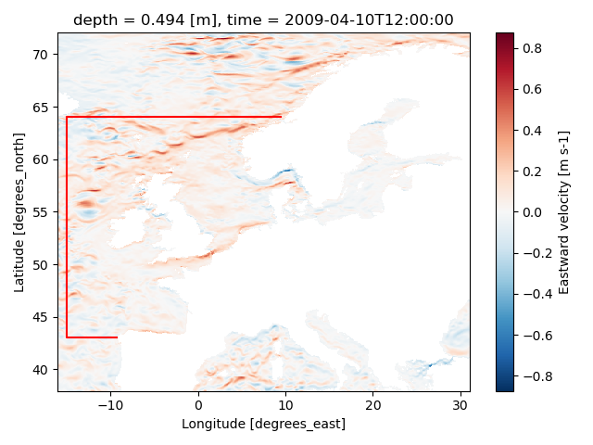
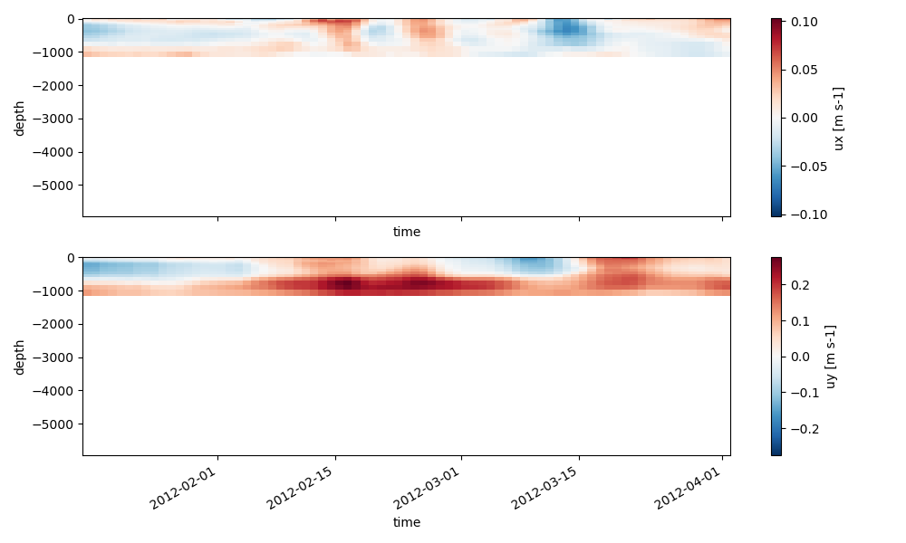
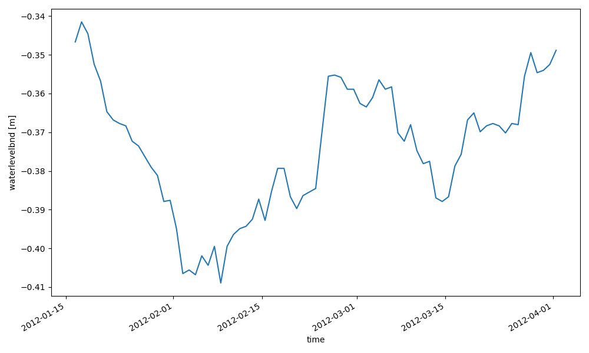
Interpolation of ocean models to polyline (.bc files)
Download ocean model data like CMEMS
HYDROLIB-core for reading polyline (red line)
xarray for reading netcdf data and .interp() to boundary support points (red line)
HYDROLIB-core for writing of bc/ext files
Examples on first support point: waterlevel, NO3, ux/uy

Slide 8
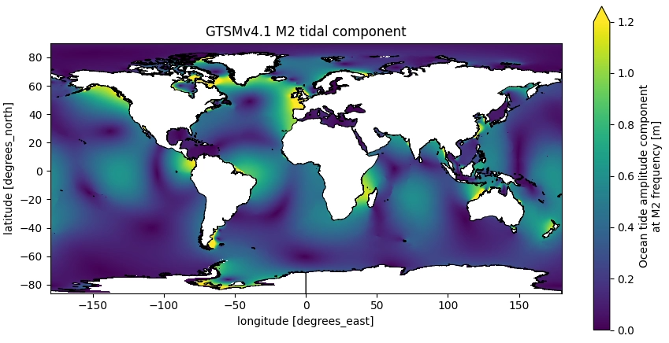
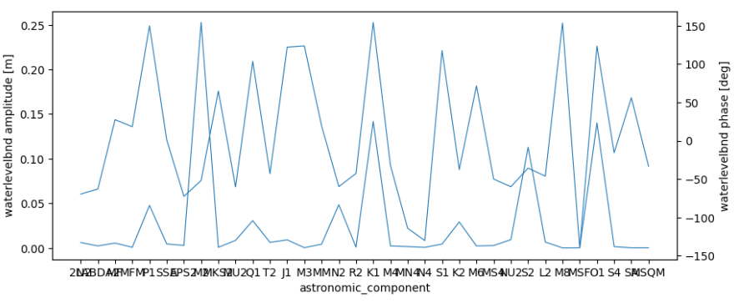
Interpolation of tidal models to boundary support points (.bc files)
Tidal waterlevel boundary
Interpolate tidal components to points in polyfile (with xarray)
Available sources: FES2014, FES2012, EOT20, GTSMv4.1
Written to Astronomic bc files (with HYDROLIB-core)
import matplotlib.pyplot as plt
plt.close('all')
import xarray as xr
file_nc = r"p:\1230882-emodnet_hrsm\GTSMv3.0EMODnet\EMOD_MichaelTUM_yearcomponents\GTSMv4.1_yeartide_2014_2.20.06\compare_fouhis_fouxyz_v4\GTSMv4.1_tide_2014_M2_rasterized.nc"
ds = xr.open_dataset(file_nc)
fig,ax = plt.subplots(figsize=(9,4.5))
ds.wl_amp.plot(vmax=1.2)
dfmt.plot_coastlines(min_area=1000, res='i', ax=ax)
ax.set_title("GTSMv4.1 M2 tidal component")
fig.tight_layout()

Slide 9
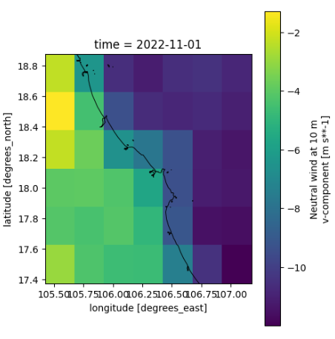
Download and convert meteo forcing
Download meteo data like ERA5 with cdsapi
Merge and convert to D-FlowFM format with xarray

Slide 10
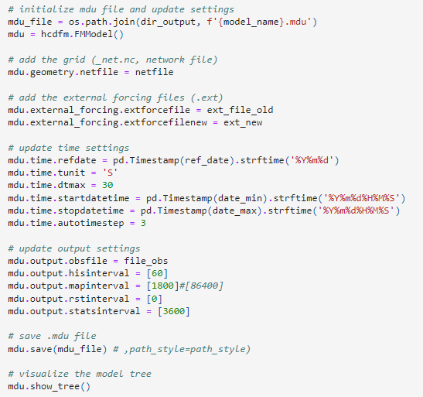
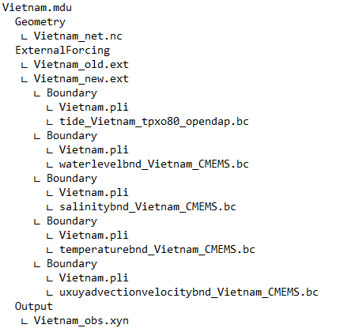
I/O of D-FlowFM input files
HYDROLIB-core for reading/writing of D-FlowFM input files (.mdu, .ext, .bc, .pli, etc.)
Validation of model structure and file contents
Adjusting model settings (mdu)
Full list of functionalities: https://deltares.github.io/HYDROLIB-core/latest/topics/dhydro_support/

Slide 11
Try it yourself
Open the modelbuilder_example.ipynb from the zip or the dfm_tools Github

Slide 12
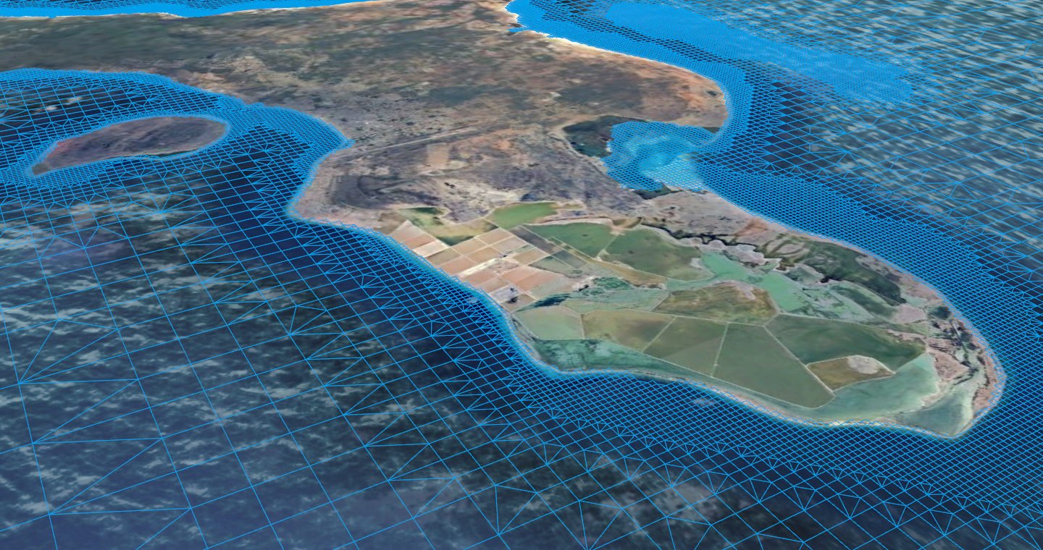
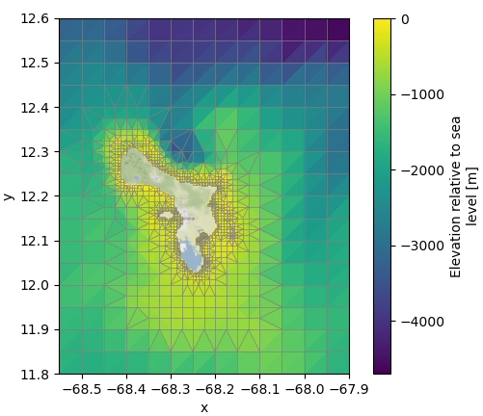
Combined into 3D Model Builder
Based on bounding box and period of interest, a 3D D-Flow FM model is created from global datasets:
Using Python libraries HYDROLIB-core, dfm_tools, MeshKernelPy, xarray and others
Grid generation and refinement (based on local water depth)
Bathymetry (GEBCO) retrieval and interpolation to grid
Initial and open boundary conditions: download and interpolate ocean currents, sea surface heights, salinity, temperature from CMEMS or others, tide from FES2014, EOT or GTSMv4.1
Meteorological forcing: download ERA5

Slide 13
Post-processing: visualization of model output

Slide 14
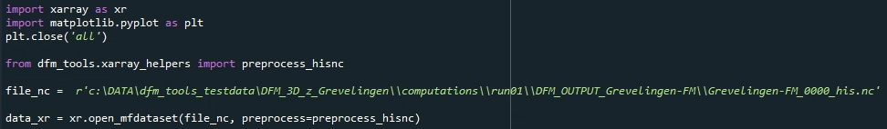
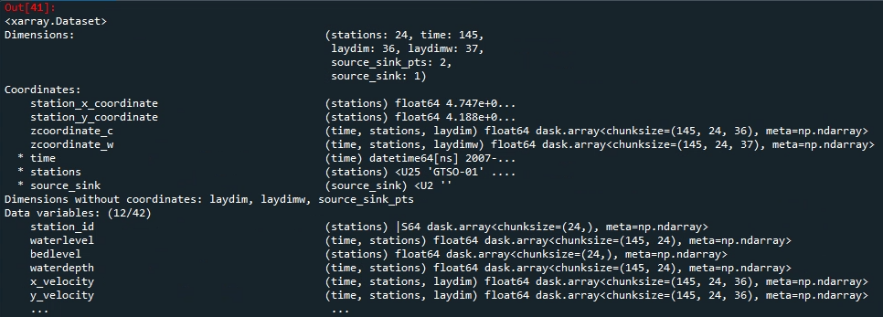
I/O of netcdf files
lazy loading of netcdf files with knowledge of the entire structure
Dask for chunking, parallelization
easy indexing over all dimensions with .isel() and .sel()
preprocess_his() enables indexing via station names (and other labels)

Slide 15
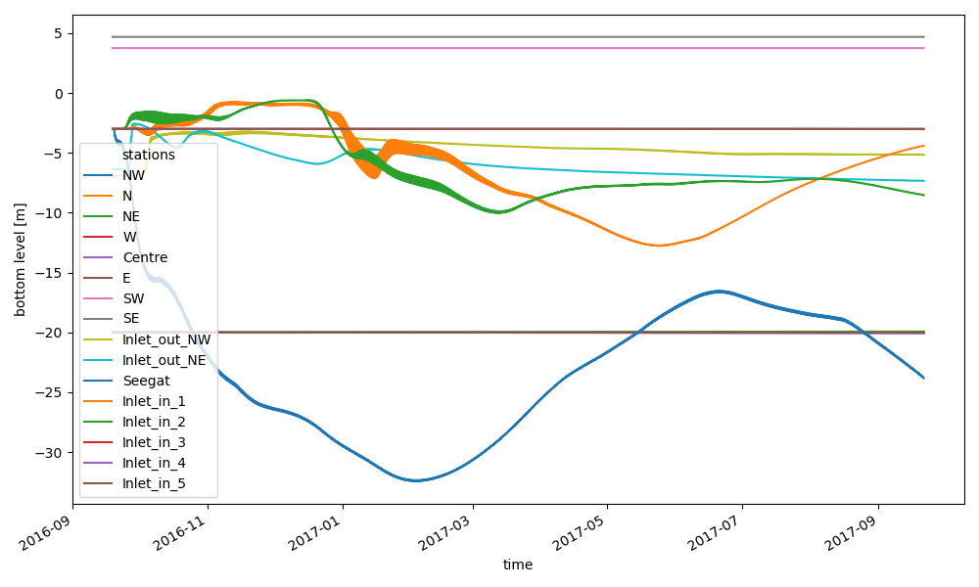
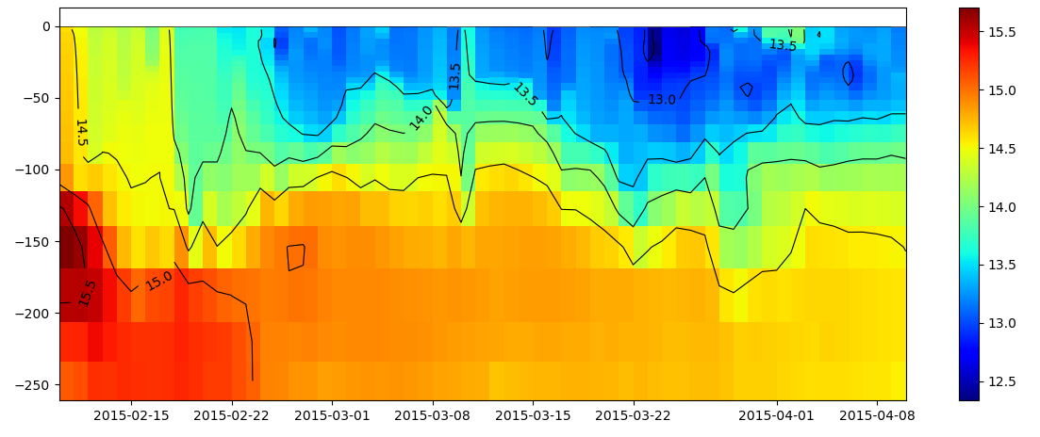
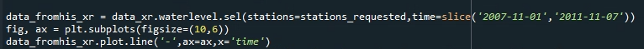
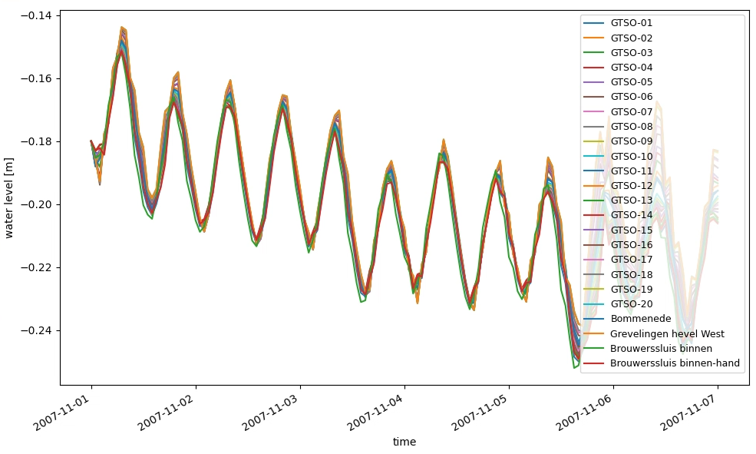
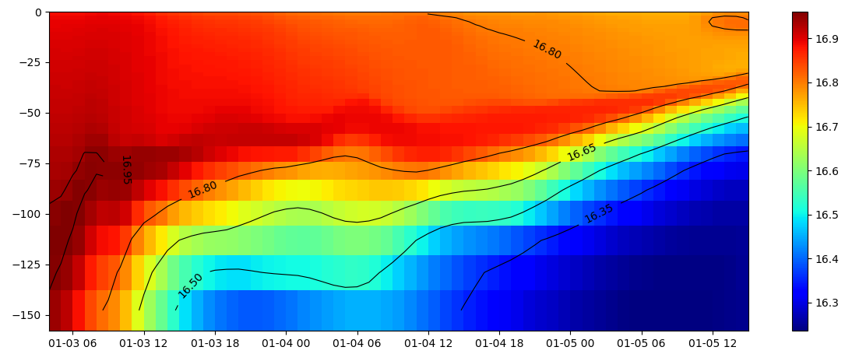
Processing hisfiles
xarray for reading D-FlowFM hisfile
subsetting of data over dimensions: time, depth, stations, cross_sections, structures, etc
Easy and flexible plotting

Slide 16
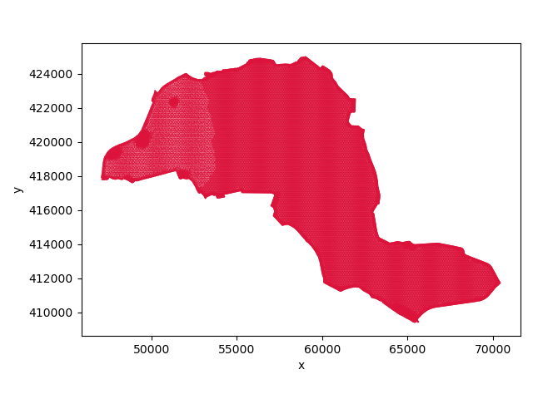
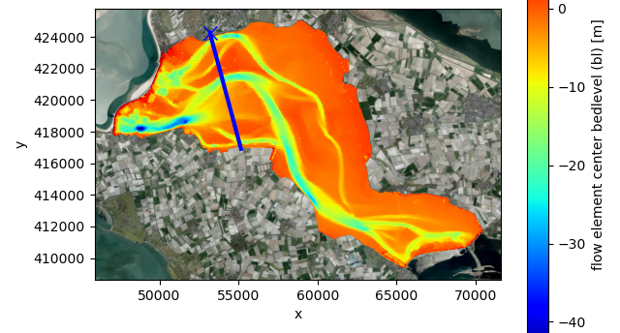
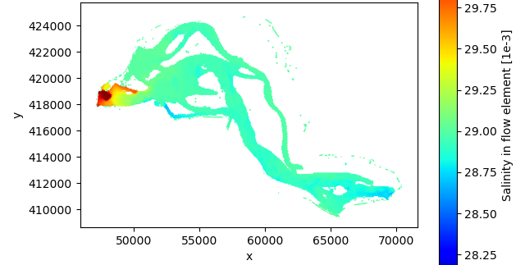
Processing mapfiles
xugrid
xarray/xugrid for reading D-FlowFM (unstructured) map/fou/rst/net files
supports partitions (handling of ghost cells)
select data based on variable and dimensions (time/layer/etc)
satellite backgrounds with contextily

Slide 17
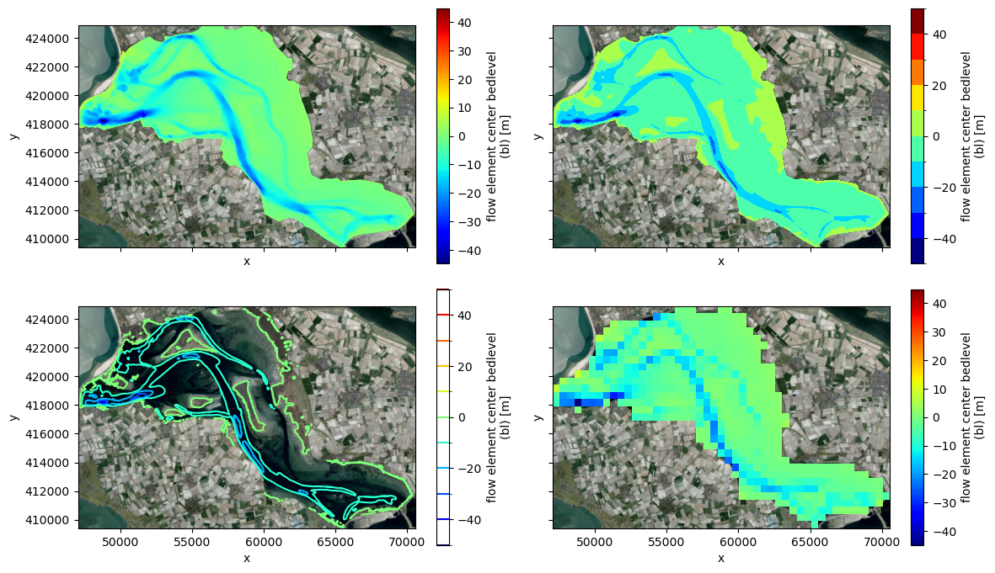
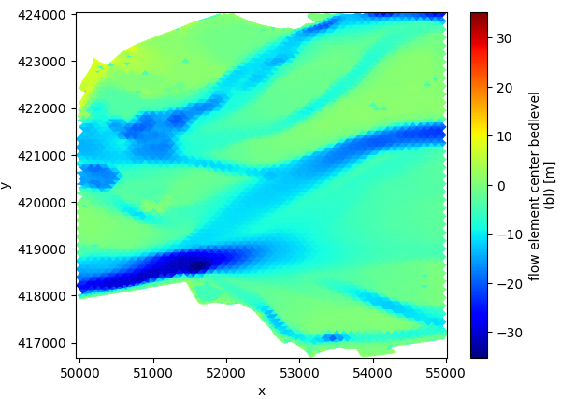
Many plotting/subsetting options
xugrid
Easy to create fancier plots like contourf or contour
Subsetting on topology
More examples in the xugrid docs

Slide 18
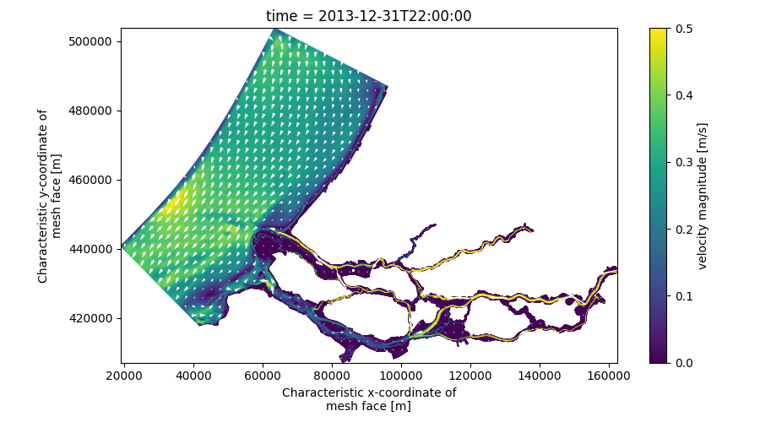
Rasterizing and regridding
xugrid
Xugrid is a powerful tool to handle topology-related operations
Rasterization to regular gridded dataset for easy distribution and comfortable quivers
Regridding, reindex_like to compare model results on different grids
More examples in the xugrid docs

Slide 19
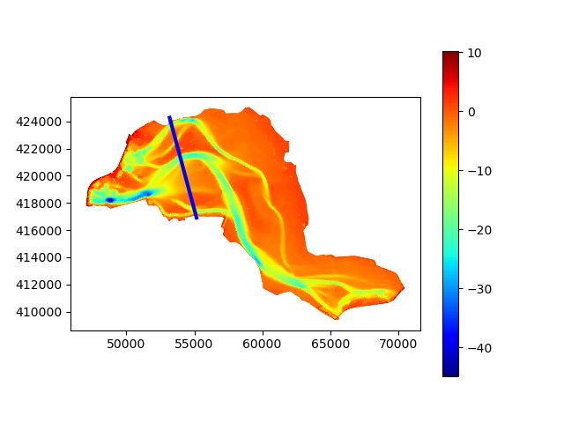
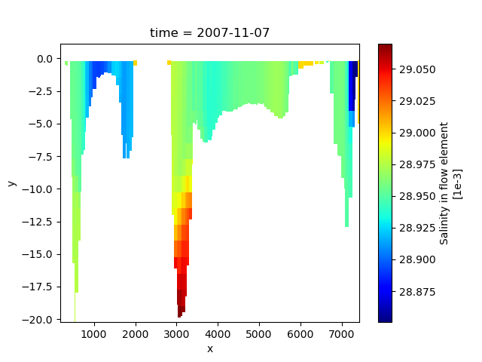
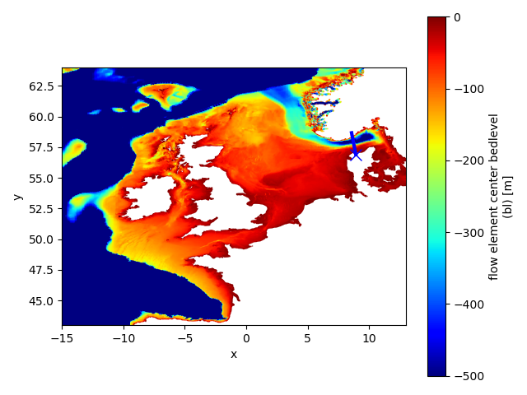
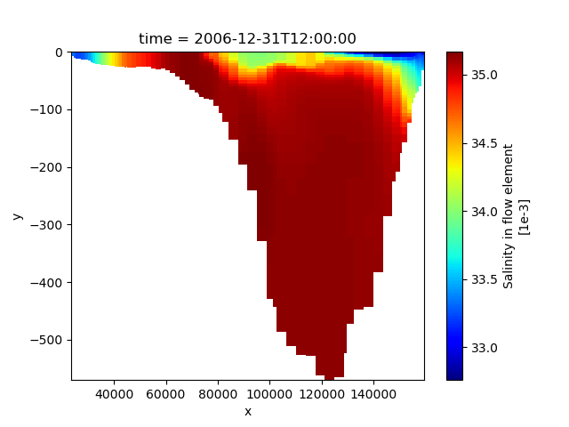
Slicing trough 3D partitioned FM map data
Along a cross-section
given a polyline (blue)
slice trough 3D partitioned FM map data

Slide 20
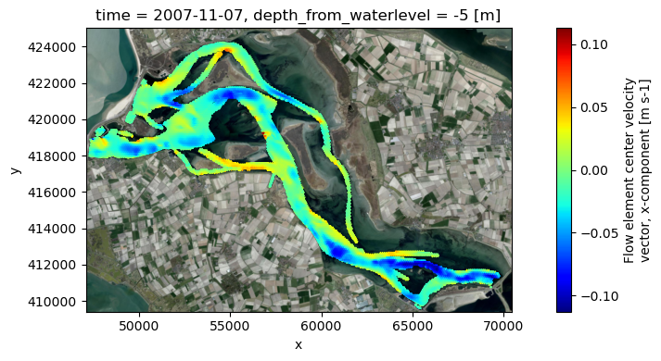
Slicing trough 3D partitioned FM map data
Along a depth referenced to z0, waterlevel, bedlevel
slice trough 3D partitioned FM map data
support for sigma, z and zsigma layers

Slide 21
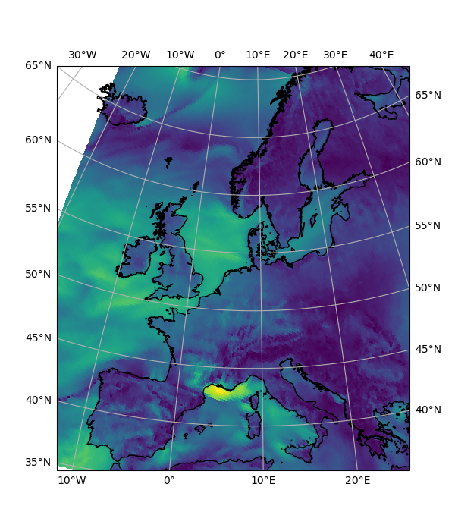
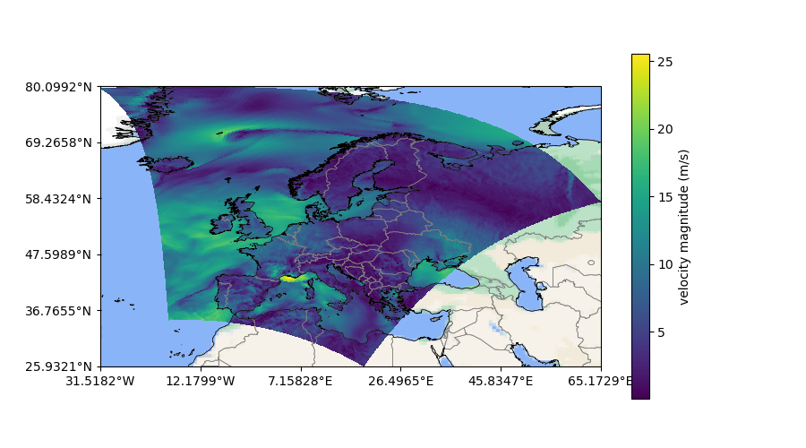
Cartopy basemaps and coastlines/borders
support for almost any epsg

Slide 22
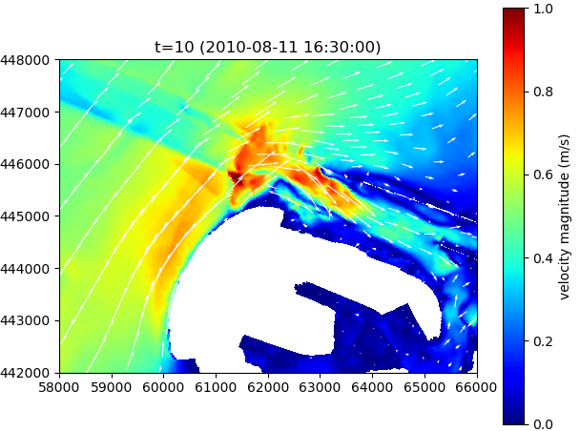
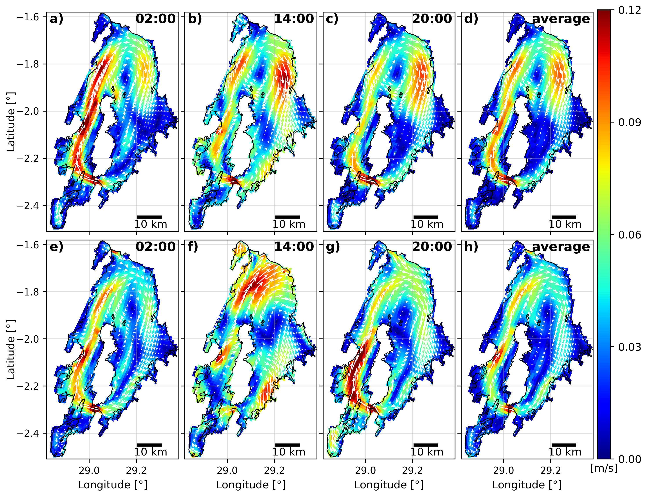
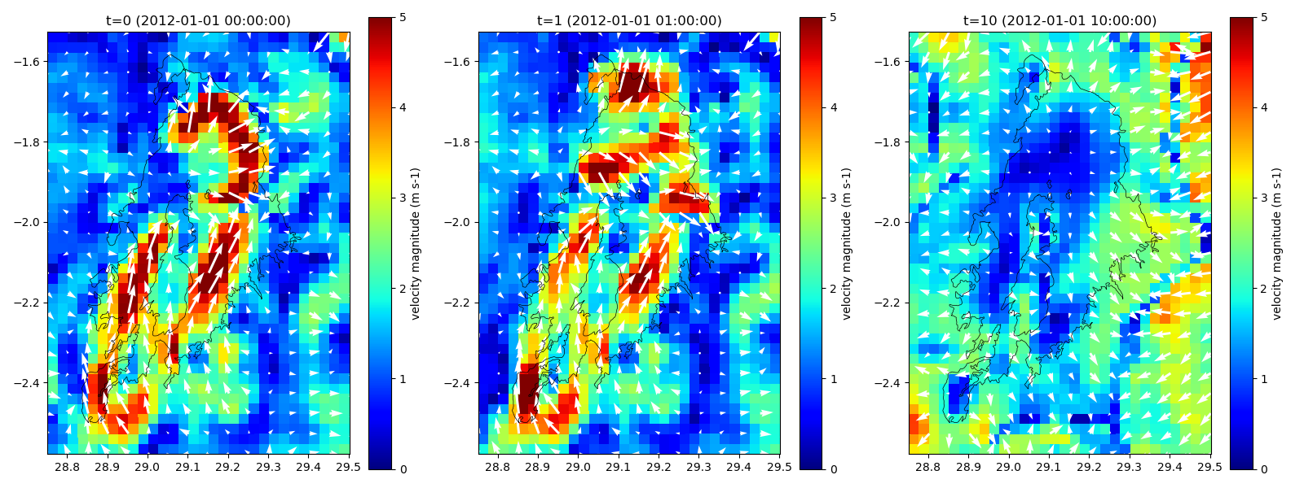
Vector plots for regulargrids
support for any other netCDF
e.g.: SFINCS, Delft3D4, oceanmodels, meteomodels

